Slide 2
INDIAN RIVER PHOTO CLUB
MEMBERS COLOR SLIDE CONTEST
JULY 28, 2022
“ABSTRACT”

Slide 3
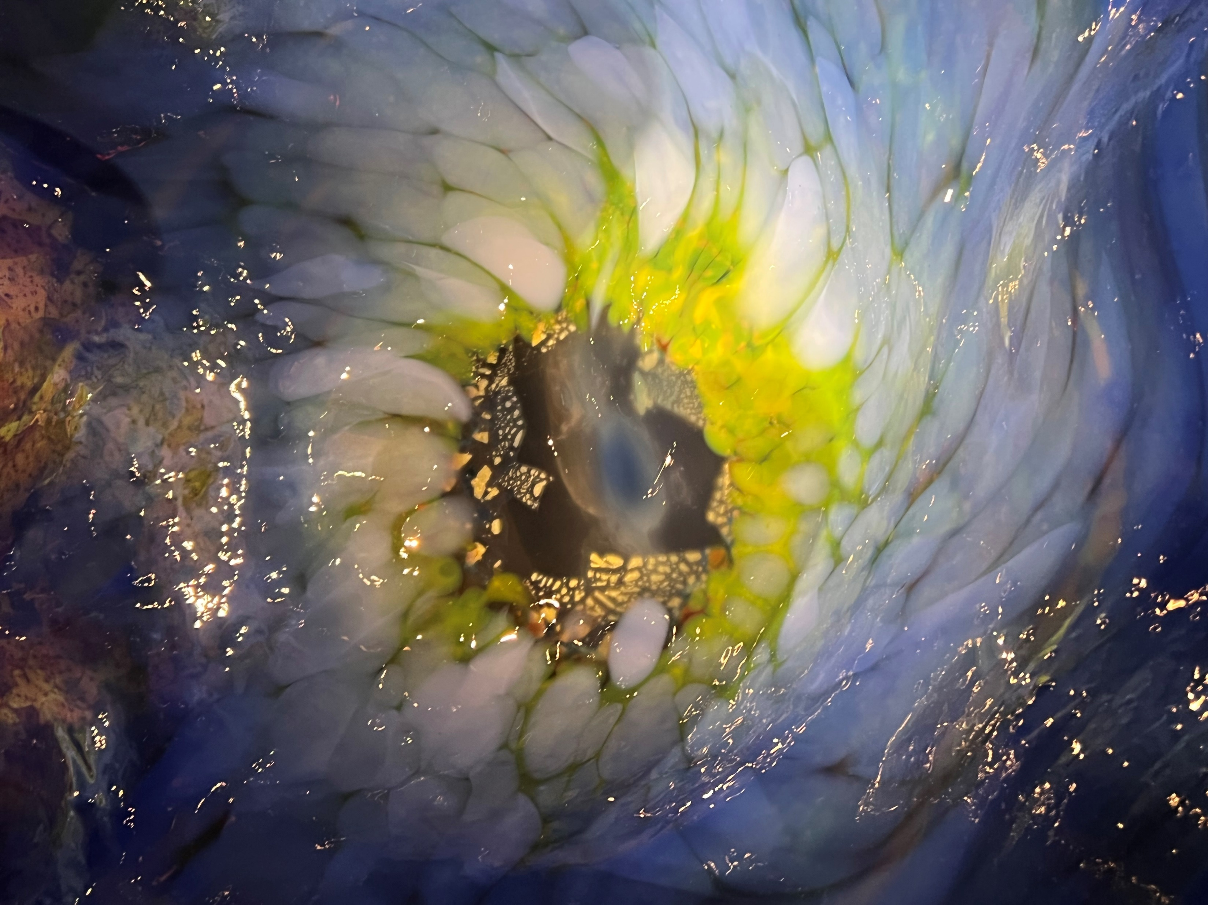
1 C
CREATION

Slide 4
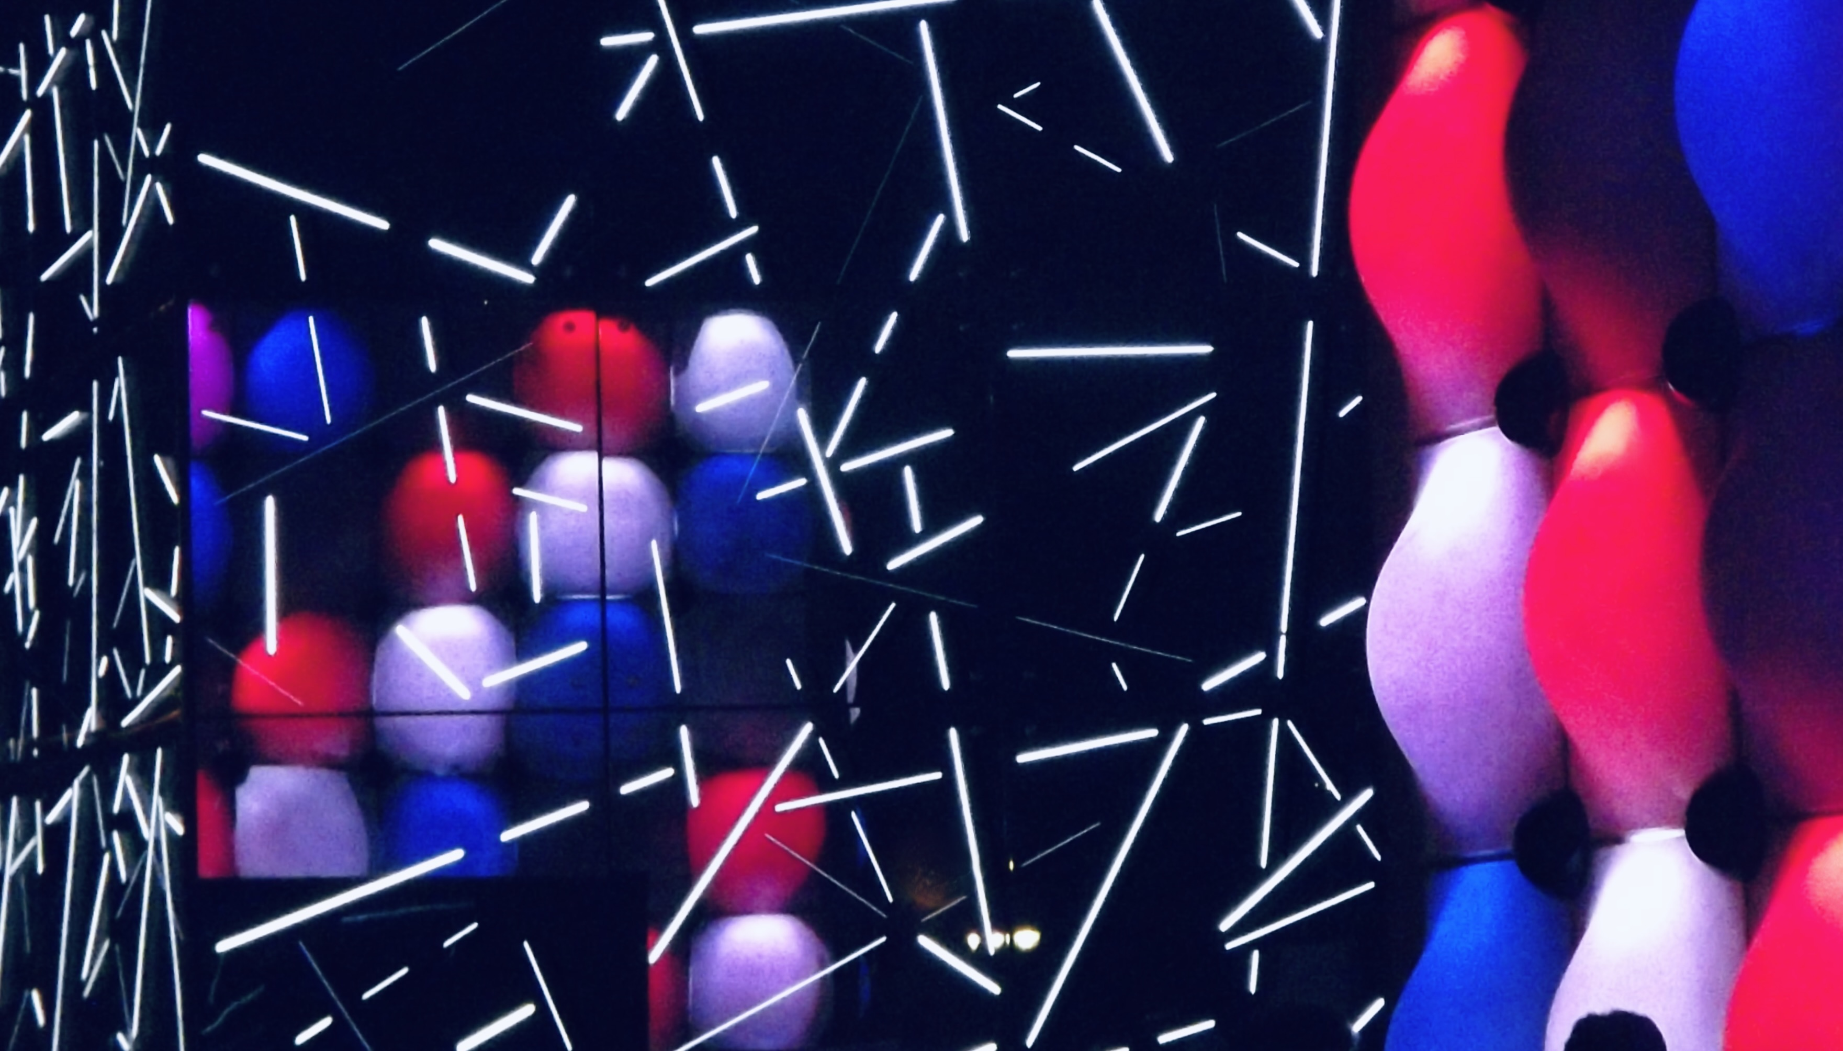
2 C

Slide 5
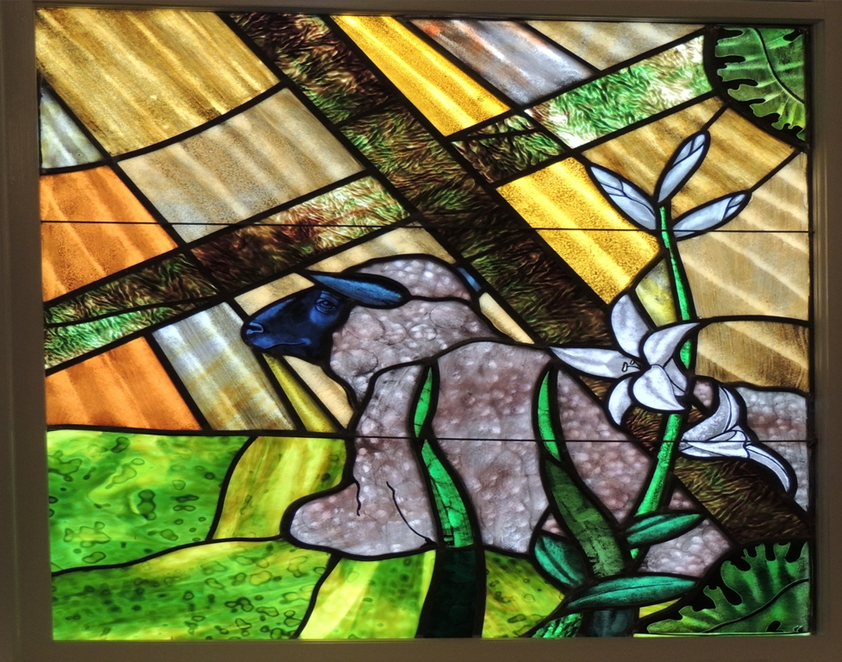
3 C
LAMB OF GOD

Slide 6
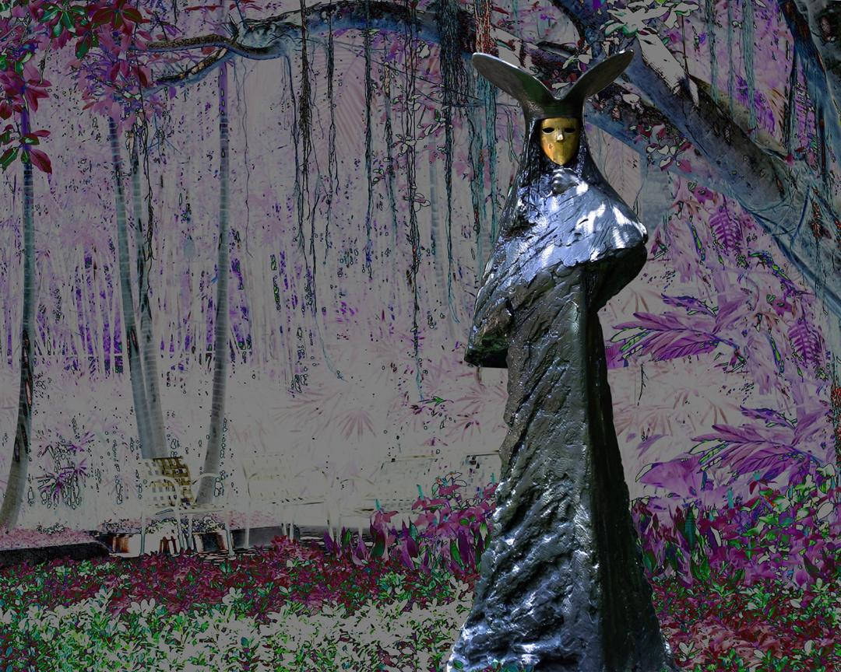
4 C

Slide 7
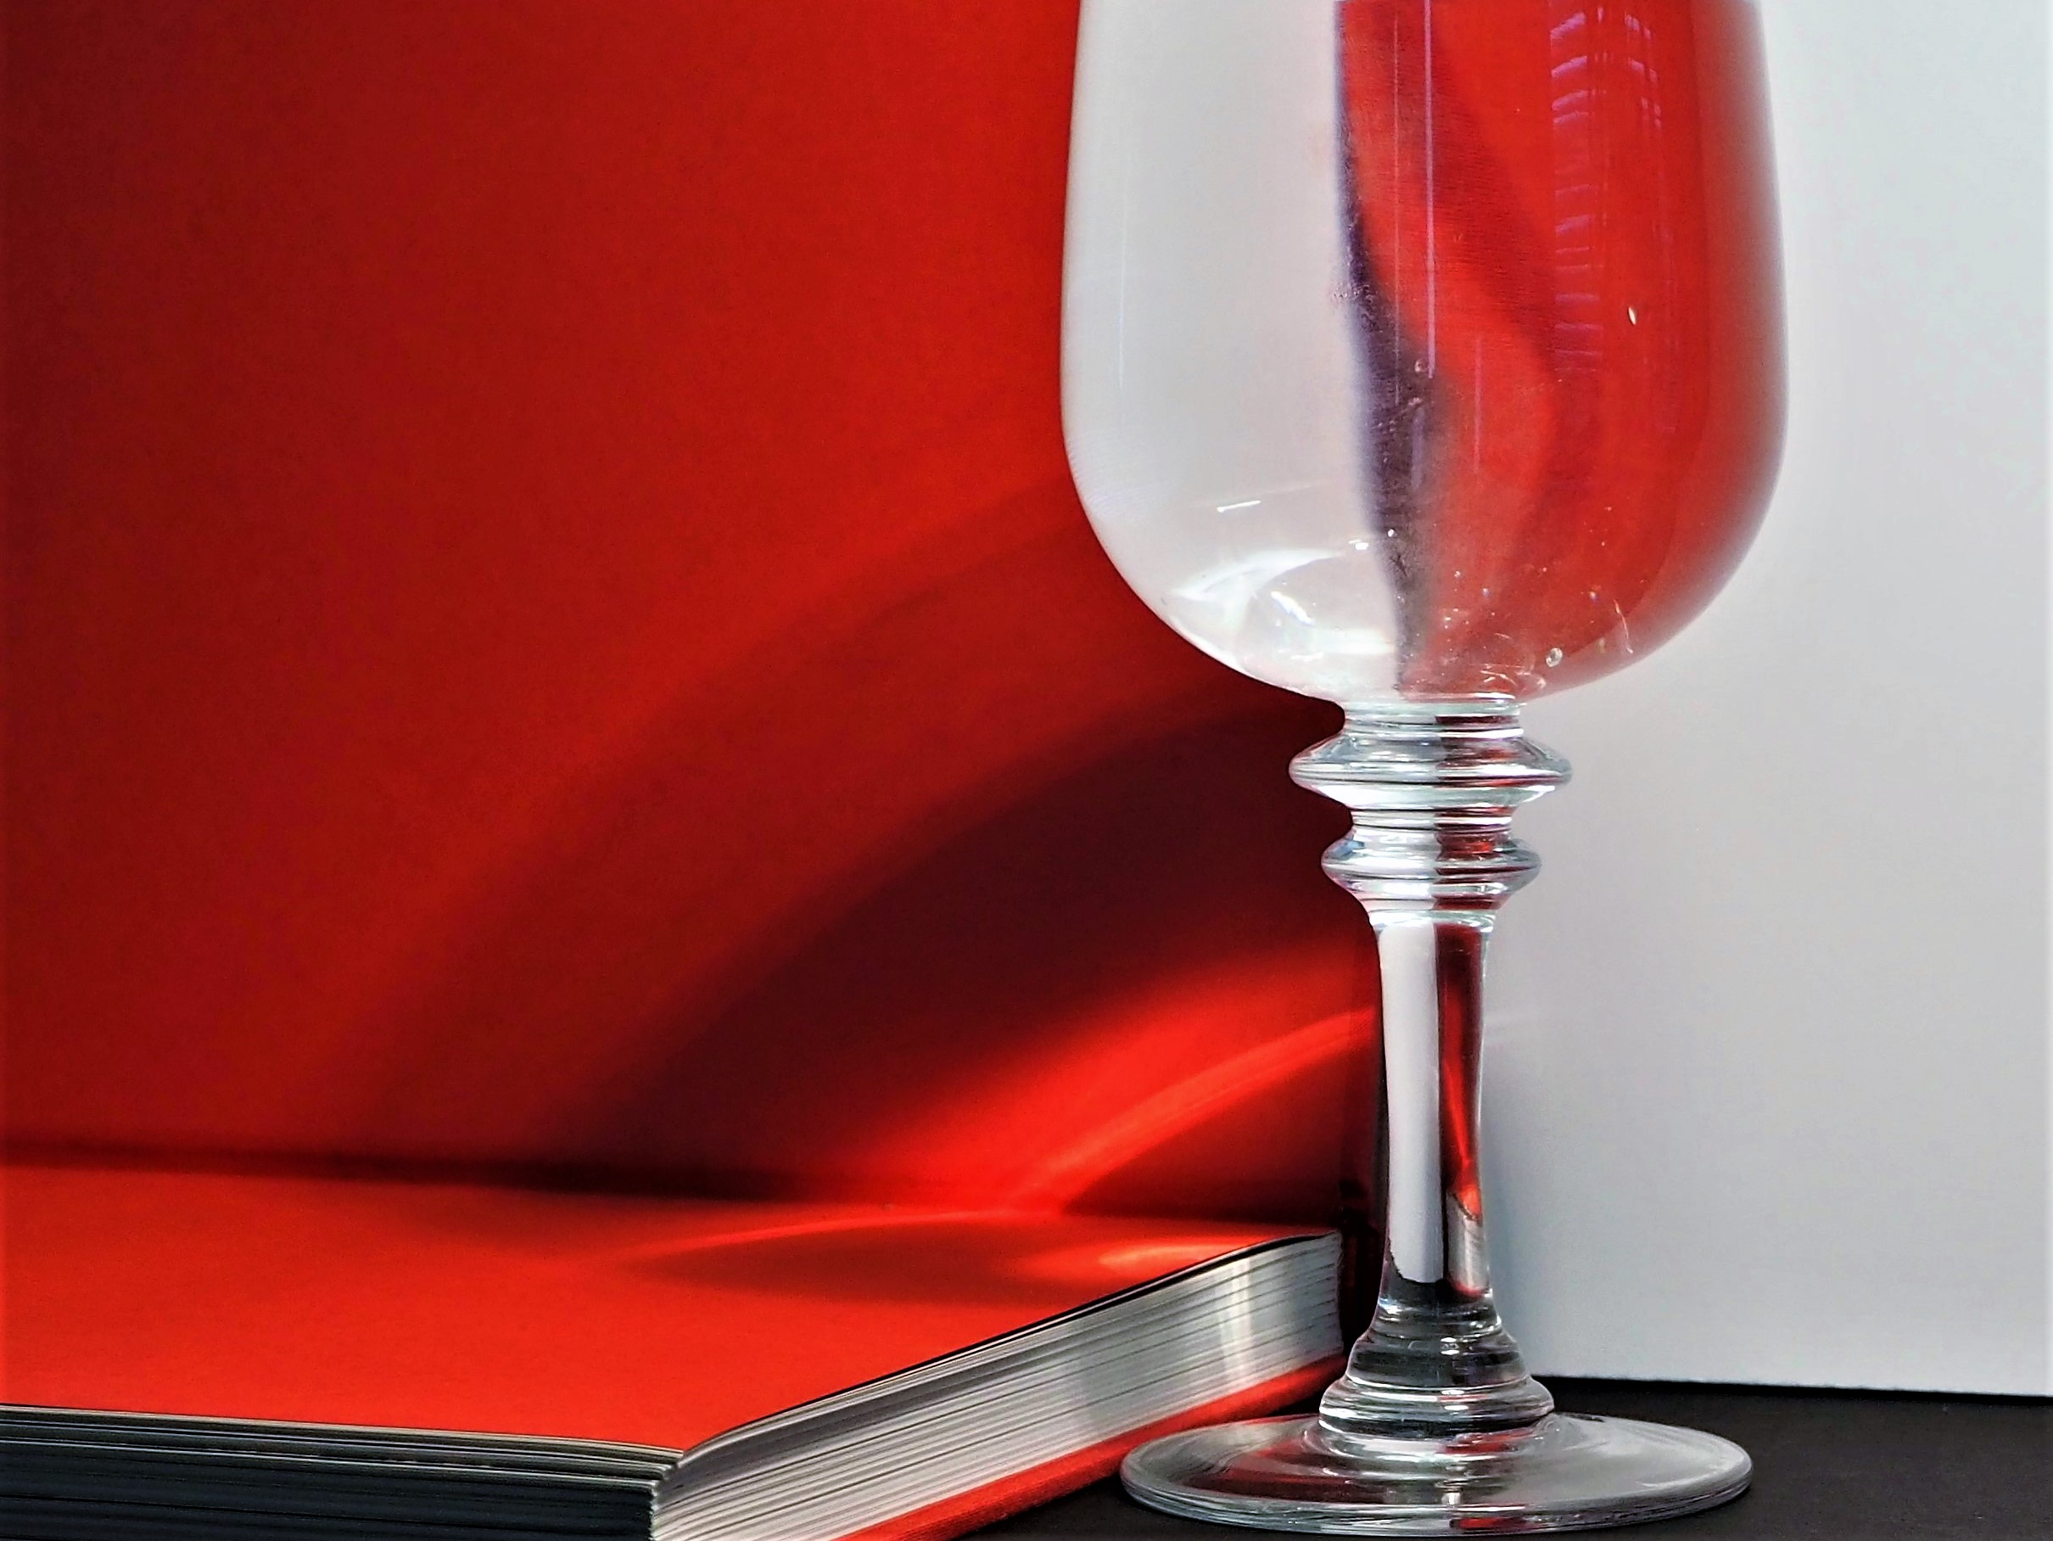
5 C

Slide 8
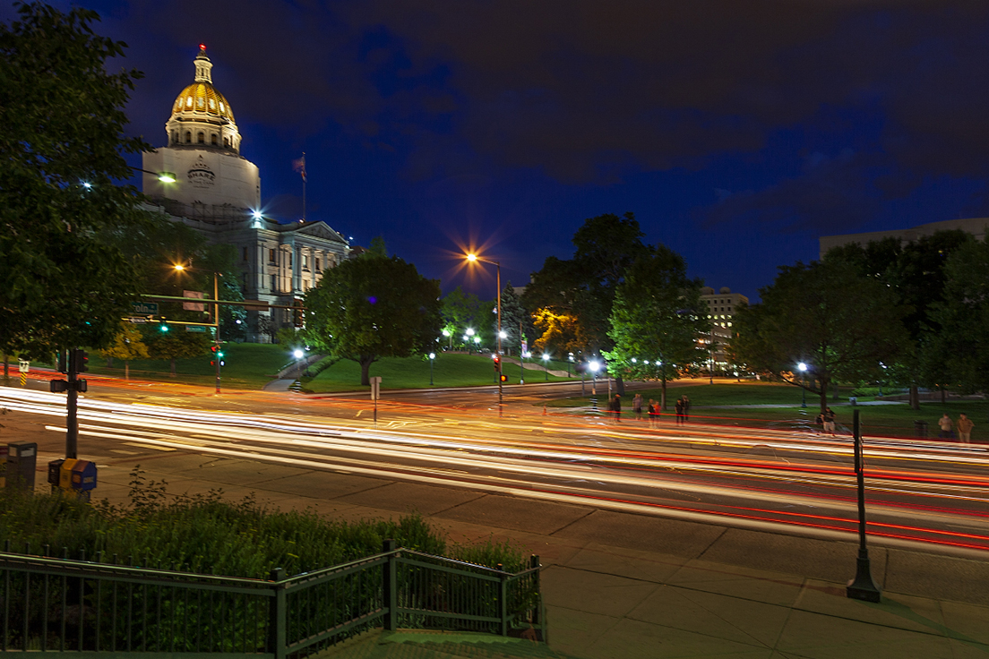
6 C
BUS STOP

Slide 9
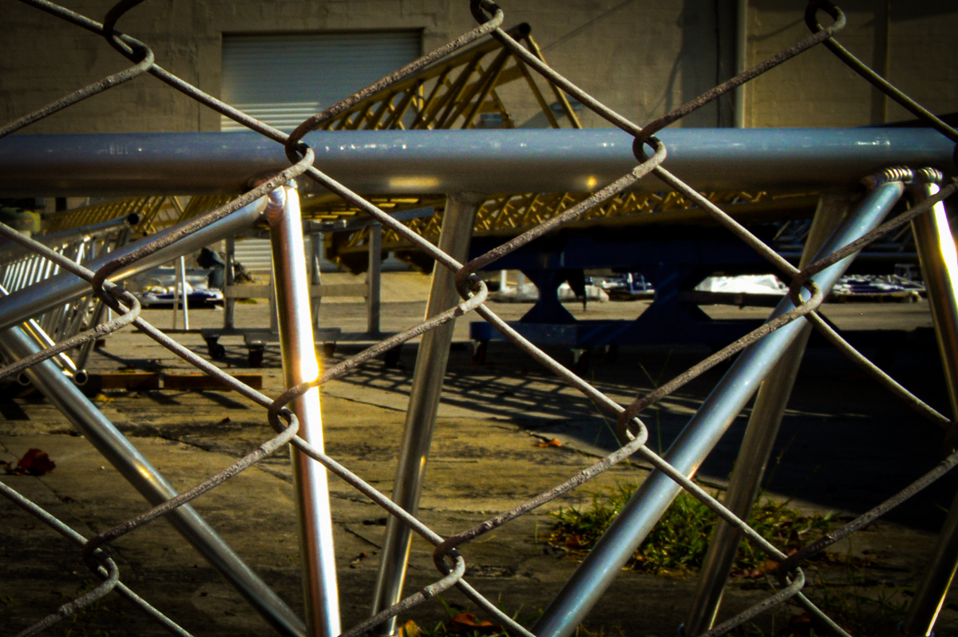
7 C

Slide 10
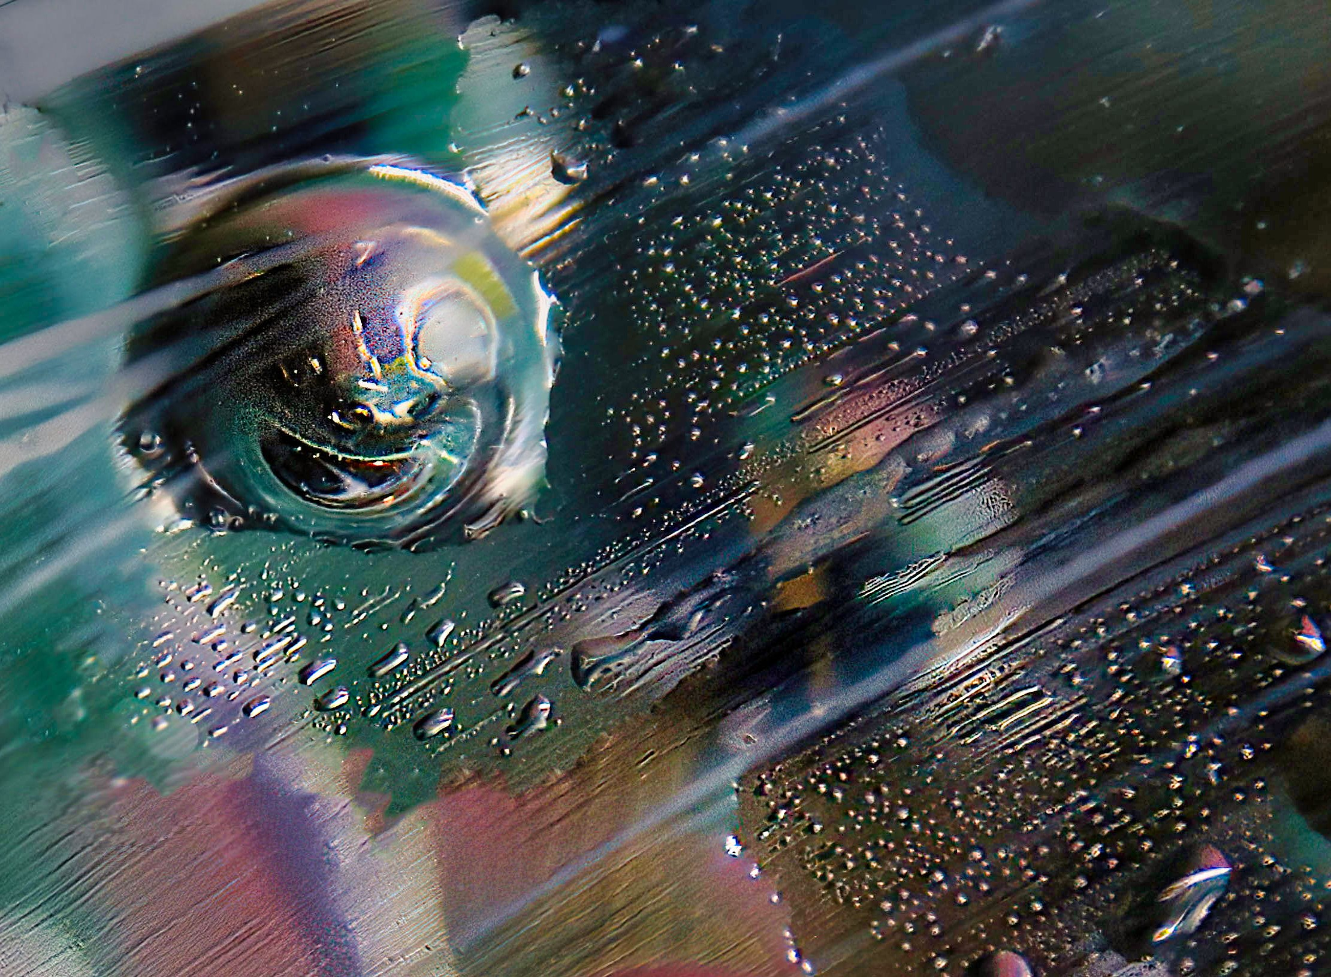
8 C
BUBBLE #12

Slide 11
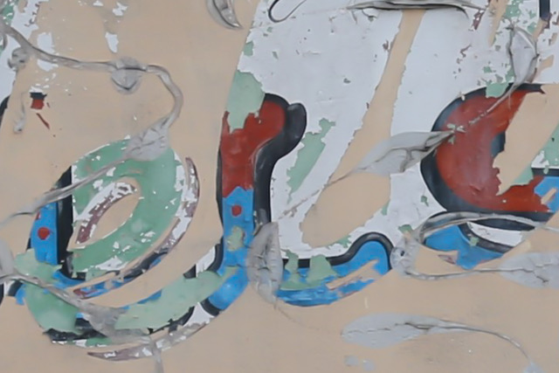
9 C

Slide 12
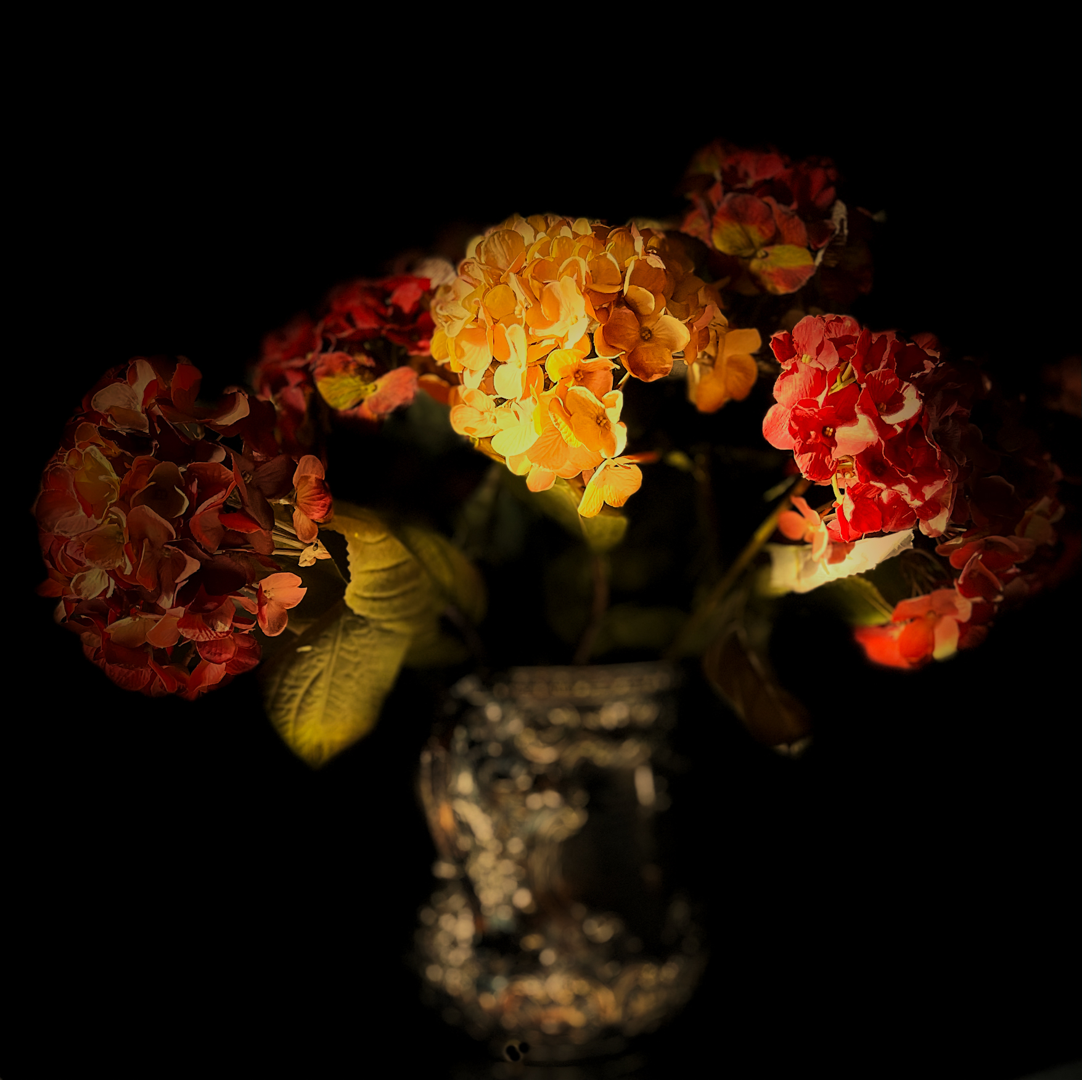
10 C

Slide 13
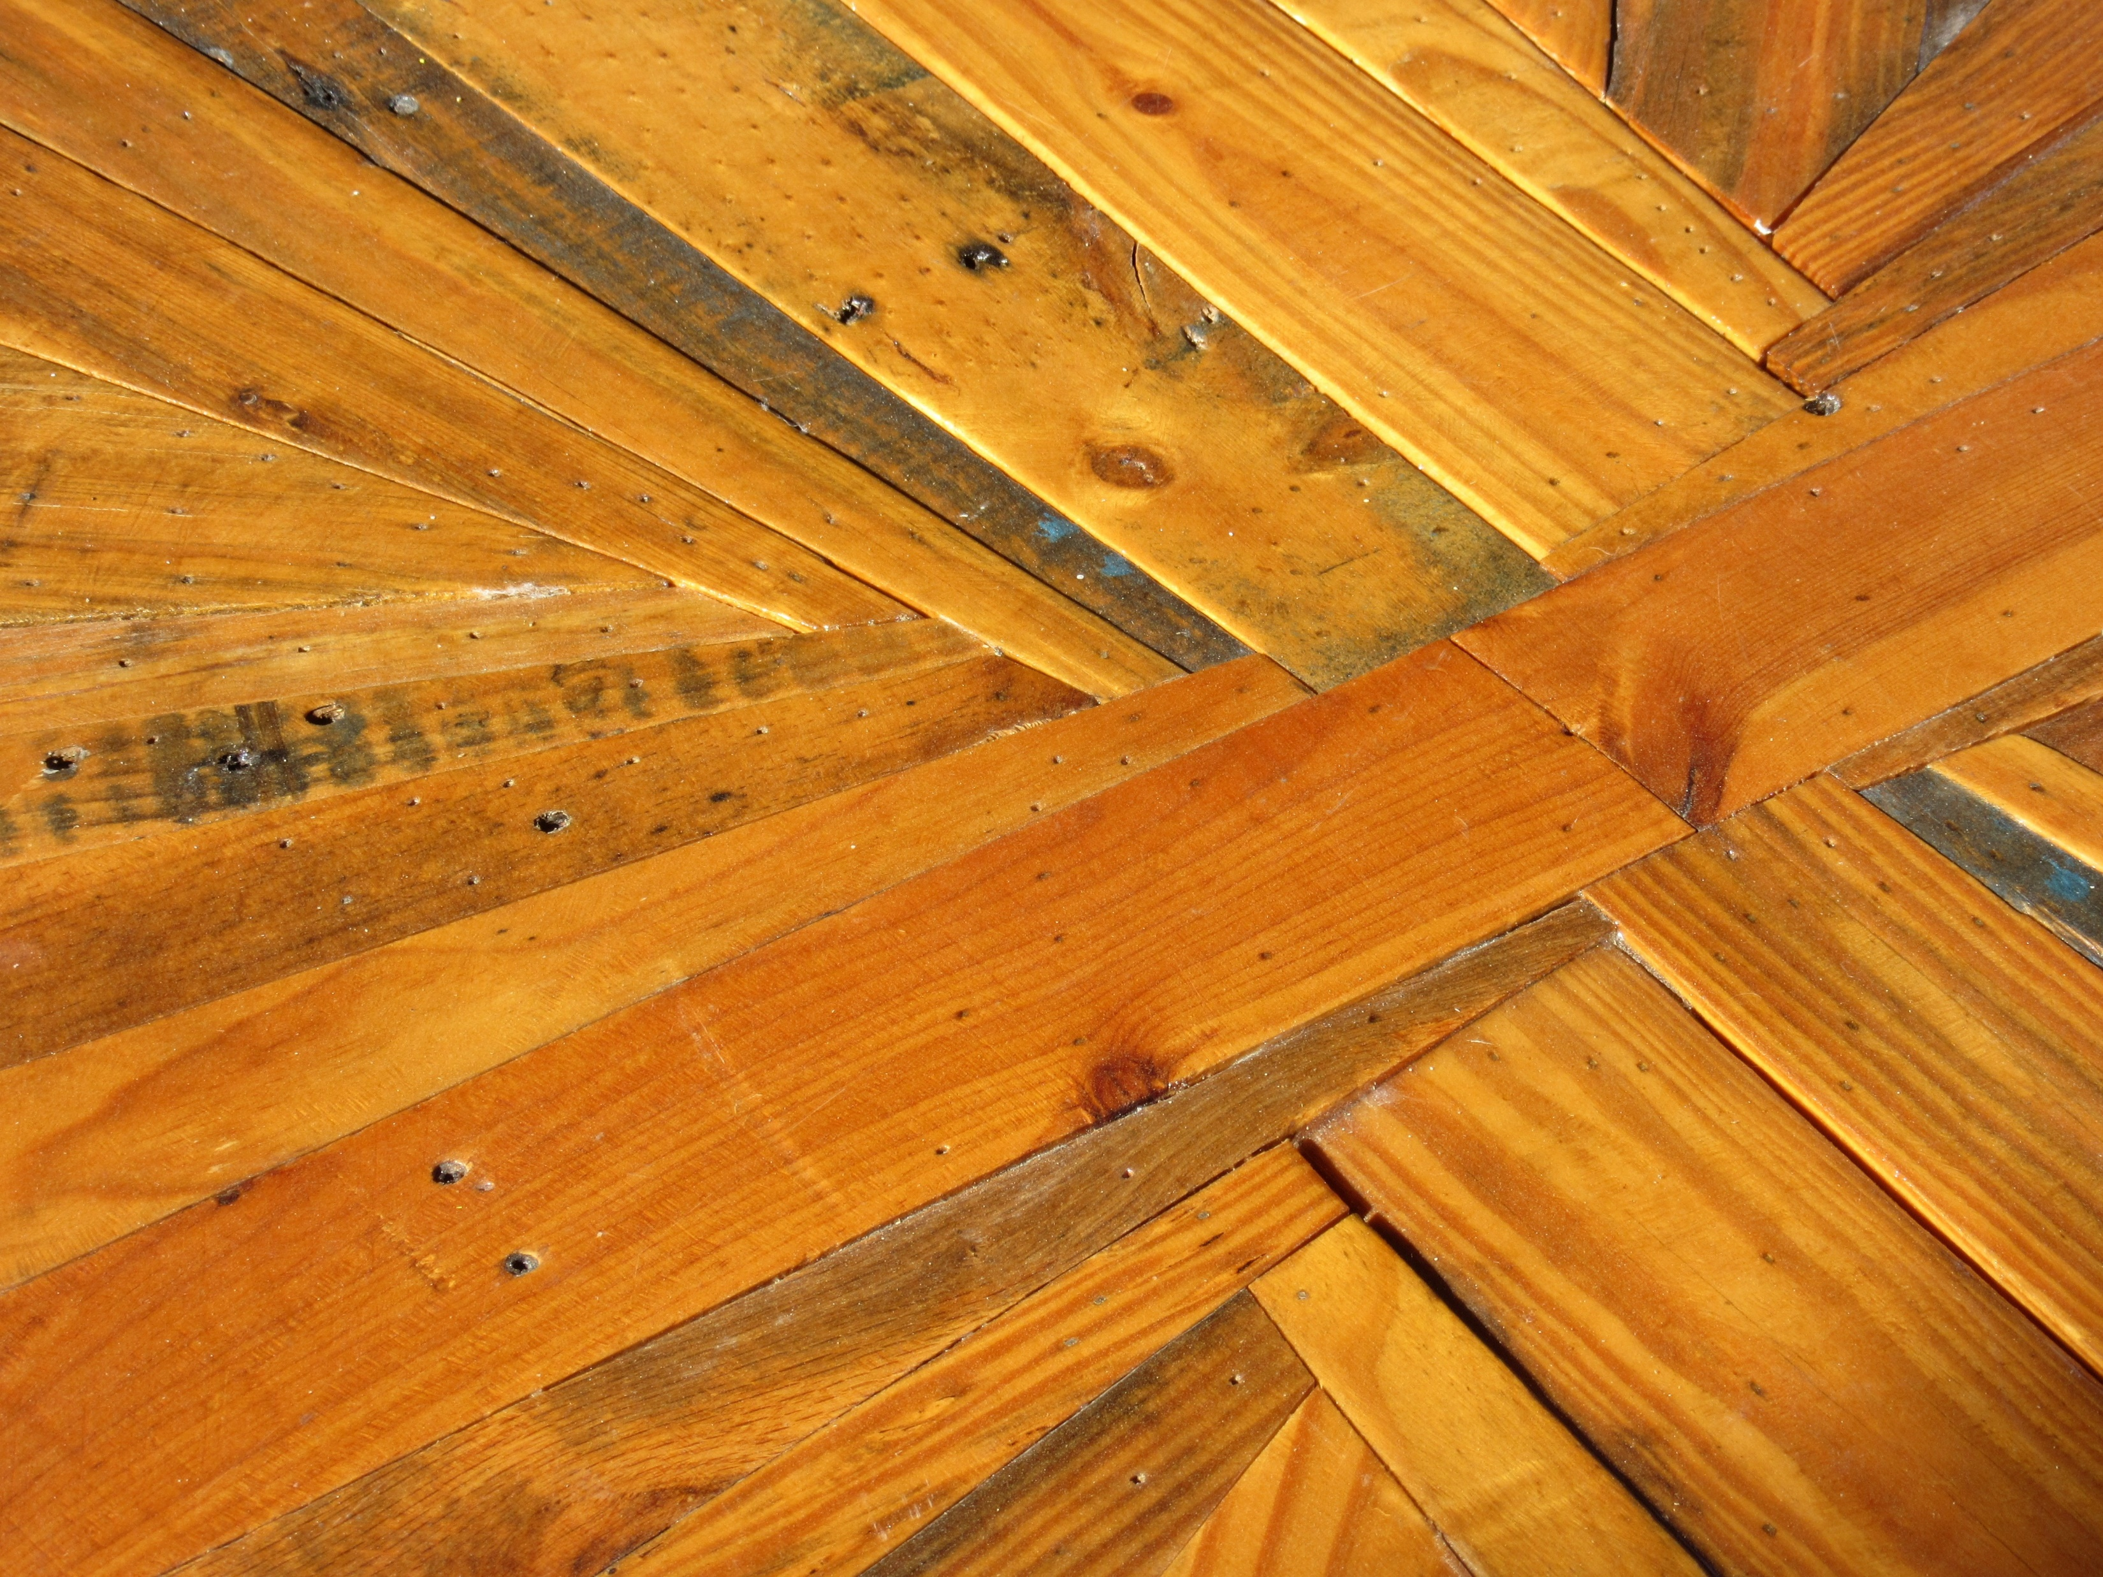
11 C

Slide 14
THANK YOU FOR YOUR PARTICIPATION

